Slide 1


Computational Thinking in
Category Theory
Ben Koo

Slide 2
Computational Thinking for MEM
What is Category Theory?
Contents
System Modeling in a Nutshell
How Does Category Theory Help?

Slide 3
Computational Thinking for MEM

Slide 4

Will “The Master Algorithm” Reframe Our World?
Bill Gates’ recommendation
The main idea of this book:
Processing data through a single universal learning algorithm— can get all the knowledge from the past, the present, and the future
Pedro Domingos, TMA, P. 25
中译本

Slide 5

教育部资助的清华大学学校特色项目： ABC 认知科学与计算思维的课程体系:
刚入门的新生导引课程，全面体验数字社会的群体运作基本机制
Strategy Analysis based-on Computational Thinking
自愿参与课程设计
的前期学生
A. Application Orientation (宏观决策者)
任务
执行方
挑战
设计方
Industry Frontier
基于数字化工作流的软件与硬件架构设计师
B. Business Operations (技术架构师)
基于计算思维的系统设计
C. Cybernetics Infrastructures (各专业领域的从业人员)
技术架构
为各领域定制的虚拟／增强现实
知识管理技术
制造业与物流服务专业
Domain-Specific Courses
超越学科界限的认知基础
Based on Legal Protocols in Global Creative Commons

Slide 6
Knowledge Container on Different Scales
Content Type | Workflow Unit | Supporting Tools
Text | Individual Activity | MediaWiki, Text Editor
Directory | Collaboration Efforts | Git, GitLab, GitHub
Micro Service | Computational Service | Docker/RTK/…
Configuration and Deployment | Development & Operations (DevOps) | Kubernetes/Trello/WeSlack
Physical Environment | Context Specific Services | Maker Space Schools

Slide 7
What you should and can learn in the MEM program?
Prof. George Mobus
University of Washington Tacoma,
Institute of Technology
http://questioneverything.typepad.com/question_everything/2013/05/

Slide 8
Layered Systems
Figure 2 on the following page
http://questioneverything.typepad.com/question_everything/2013/05/

Slide 9
Input-Output Systems (Measurement and Feedback)
Prof. George Mobus’ Blog (Figure 3 on the following page)
http://questioneverything.typepad.com/question_everything/2013/05/

Slide 10

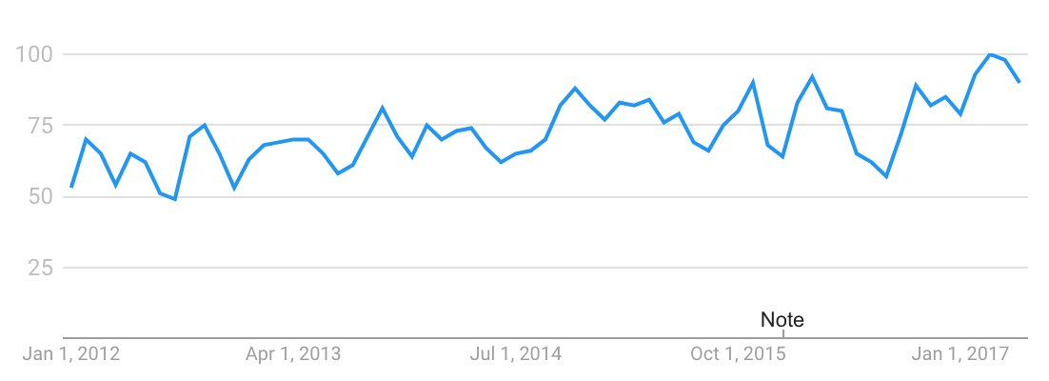
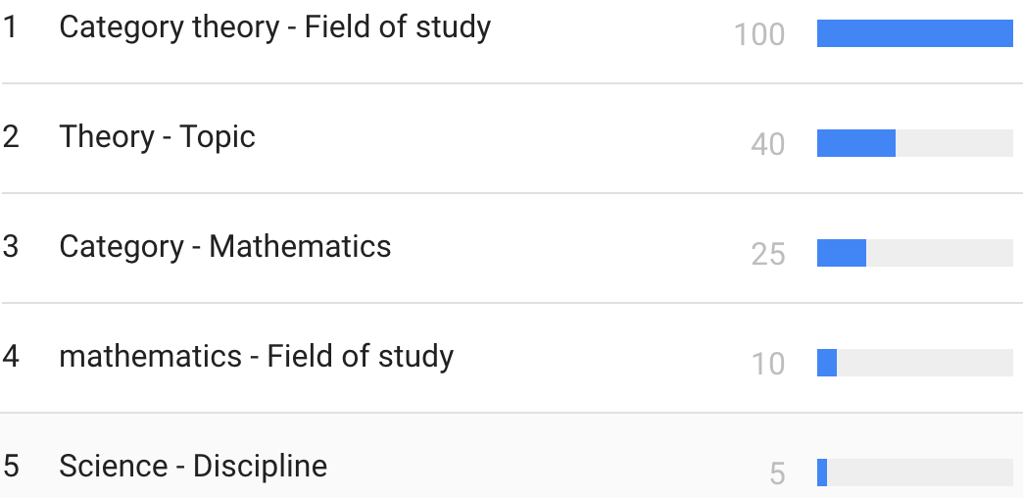
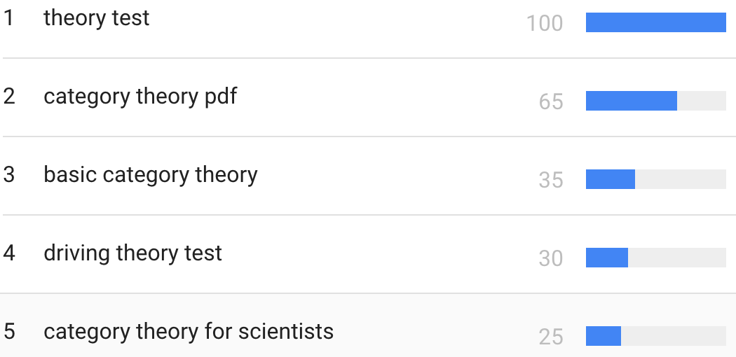
Trend
Based on
“category theory” interest over past 5 years (worldwide):
Legend:
Numbers represent search interest relative to the highest point on the chart for the given region and time.
A value of 100 is the peak popularity for the term.
A value of 50 means that the term is half as popular.
Likewise a score of 0 means the term was less than 1% as popular as the peak.
Related topics
Related queries
Legend
The most popular topics. Scoring is on a relative scale where a value of 100 is the most commonly searched topic, a value of 50 is a topic searched half as often, a value of 0 is a topic searched for less than 1% as often as the most popular topic.
Legend
The most popular topics. Scoring is on a relative scale where a value of 100 is the most commonly searched topic, a value of 50 is a topic searched half as often, a value of 0 is a topic searched for less than 1% as often as the most popular topic.
Notes:
Category theory has become an important role in contemporary mathematics and theoretical computer science.

Slide 11
01. What is Category Theory?

Slide 12
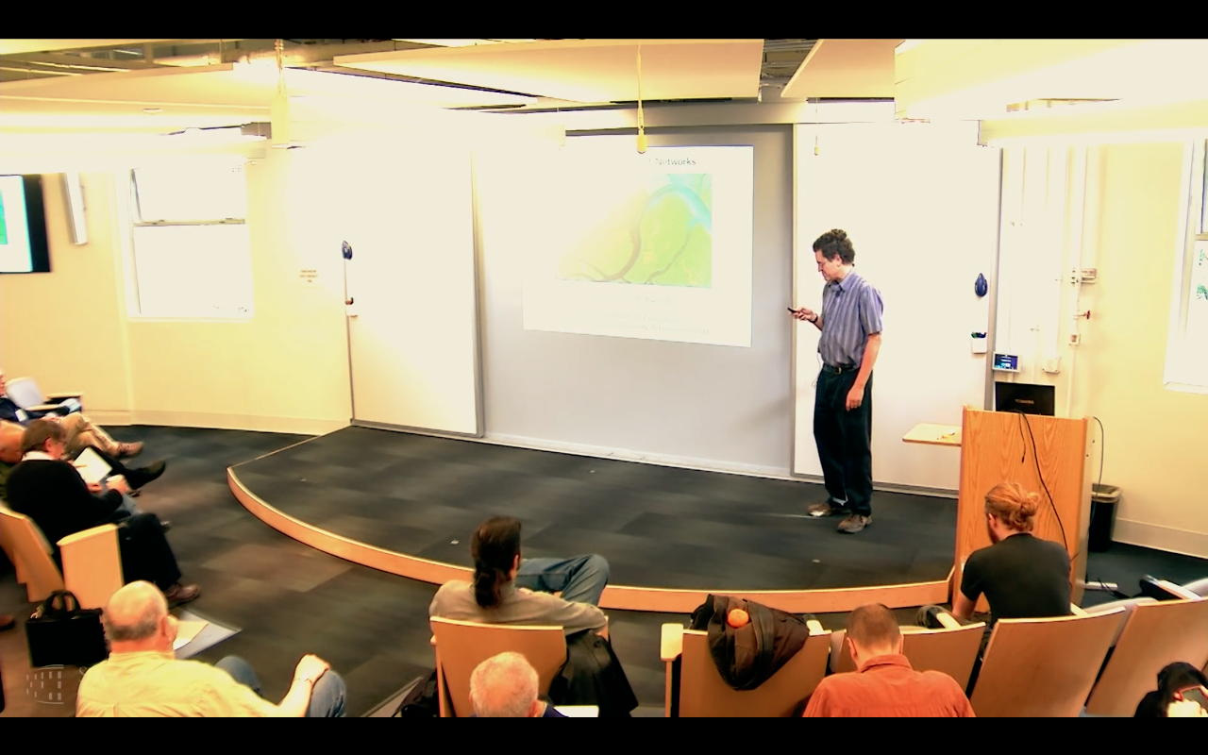
Preface
John Baez* : “Category Theory is the Mathematics of networks.”
https://www.youtube.com/watch?v=IyJP_7ucwWo
Based on Marquis, Jean-Pierre on Stanford Encyclopedia of Philosophy**: “Category theory has become an important role in contemporary mathematics and theoretical computer science. It is a powerful language, or conceptual framework, allowing us to see the universal components of a family of structures of a given kind, and how structures of different kinds are interrelated”
Source: *John Baez’s Stuff, http://math.ucr.edu/home/baez/
**Jean-Pierre Marquis, https://plato.stanford.edu/archives/win2015/entries/categorytheory/
Notes:
Category theory has become an important role in contemporary mathematics and theoretical computer science.

Slide 13
Category Theory: Computation without numbers
A Category is a diagram composed of Objects and Arrows
B
f
g
A
C
Example: A Category with 3 objects (A,B,C) and two arrows (f, g)

Slide 14
What is a Category?
A Category must satisfy the following conditions.
id_{B}
B
f
g
A
C
id_{A}
id_{C}
A collection of objects and a collection of arrows
Every object X must implicitly has an identity function id_{X}
Two or more arrows can be composed into another arrow

Slide 15
Category is all about composing functions
Two arrows ( f, g ) can be combined (composed ) into one arrow h
B
f
g
A
h
C
The essence of Category Theory is to represent the composability of functions

Slide 16
Category Theory computes with Diagram (Arrow) Chasing
B
B
Always implies:
f and g can be
composed into
h
where
h = g ◦ f
f
g
f
g
A
h
C
h = g ◦ f
A
C

Slide 17





Arrows are “mappings” between objects, categories and functors
2. Functor
B
$$S$$
$$\underset{→}{ F }$$
$$T$$
E
$$S \underset{→}{ F } T$$
A
C
D
F
Functor $F$
Map[F, List[1,2,3]] =
List[F[1], F[2], F[3]]
Image source: http://www.math3ma.com/mathema/2017/1/31/what-is-a-functor-part-1

Slide 18
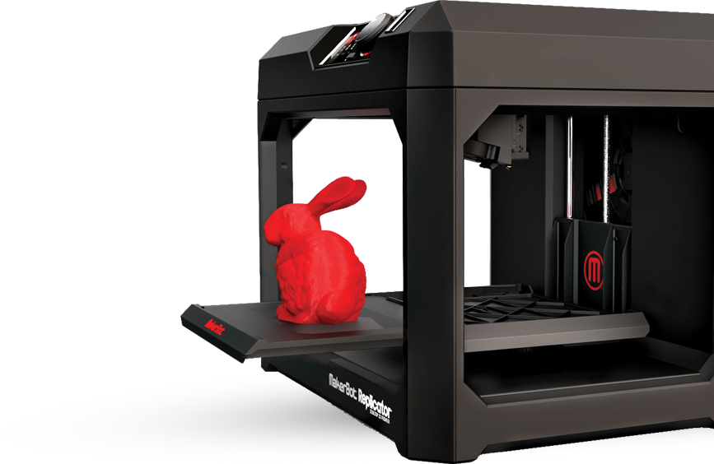

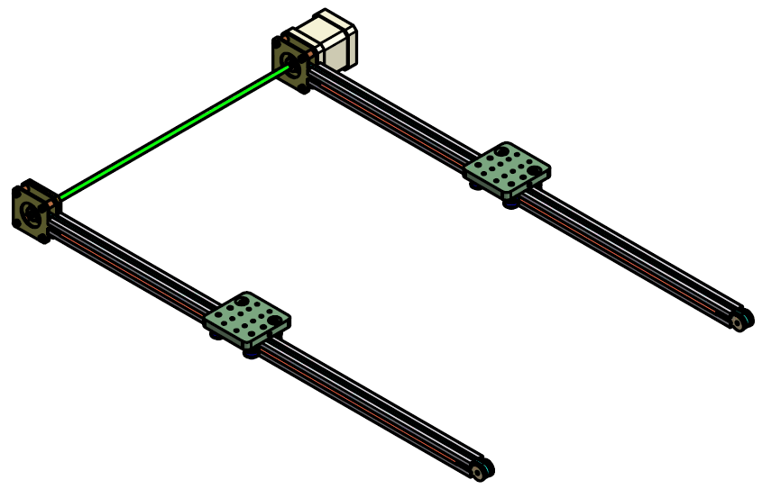
How are arrows chased and composed in real life?
Here’s another example :
C
C ^{OP}
3D printing
3D printing
F ^{op}
f
g
f ⁻¹
g ⁻¹
2D printing
1D movement
(Opposite Functor)
2D printing
1D movement

Slide 19
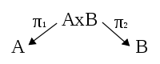
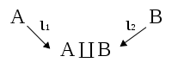
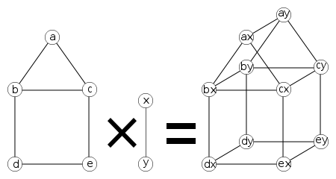
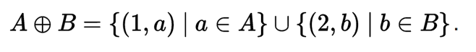
How are arrows chased and composed in real life?
Here’s another example :
Product
Sum(Co-Product)
F ^{op}
(Opposite Functor)
Source :https://en.wikiversity.org/wiki/Introduction_to_Category_Theory/Products_and_Coproducts_of_Sets

Slide 20
02. Real life diagrams

Slide 21
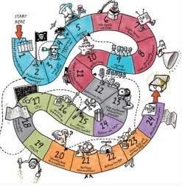
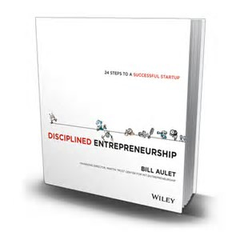
A Diagram of Product Development Process by Bill Aulet of MIT

Slide 22
Product Design and Development Process redrawn with arrows
Initial Idea
Identify Customer Needs
Establishing technical specification
Initial Idea
Collecting competitive benchmarking
Identify Opportunities
List of Customer Needs
List of Opportunities
Reflect on the result and the process
Evaluate and Prioritize Project
Establish the relative importance
Reflect on the result and the process
Filtered Opportunities
Filtered Customer Needs
Allocate Pre-project Planning
Interpret raw data in terms of customer need
Project Idea
Customer Needs Raw Data
Gathering Raw Data
Re-evaluate Result and Process

Slide 23
Product Design and Development Process redrawn with arrows
Target Specification
Concept Generation
Establishing technical specification
Final Product Concept
List of Metric Specifications
Measuring & interpreting concept
Reflect the result and the process
Collecting competitive benchmarking
List of Survey Result
Surveying concept
Competitive Evaluation List
List of Concept Scoring
Set Ideal marginal value
Scoring
Re-evaluate screening
Re-evaluate Result and Process
Target Specification List
List of Concept Screening
Screening
List of Concept Generation
Determining concept generation

Slide 24
03. How Does Category Theory Help?

Slide 25



Juicero Case
What happened?
120M USD
Doug Evans
Notes:
Initial idea:
Innovative small press could change the juicing industry.
Identify Customer Needs:
Customers need juice or a press?
Customers need fast and clean juice making
Smart phone app to monitor their diet
Target Specification:
Thousands of pounds on 200 cm² surface press
Home appliance or Businesses?
Producing a juice in <90 s
Concept Generation:
Over engineered (24 pieces for the lock door system).
Cold pressured
QR scan to apply the exact pressure.
-----------------------------------------------------------------------------------------------

Slide 26






Juicero by using Category Theory
C
g
h
h·g
F (Functor)
F (Functor)
Maps similar structures across categories
D
Notes:
Nespresso borrowed the insights from Hp, basically “If selling replacements is succesful then we have to focus on the replacements to succeed”
Borrowing experiences across industries to overcome Industry Barriers and failing one and again with the same complex problems.

Slide 27

Juicero by using Category Theory
Development Process
g
h
C’
F
h·g
F (Functor)
αG
C’’
Category Company C
F’ (Functor)
C’’’
Notes:
Nespresso borrowed the insights from Hp, basically “If selling replacements is succesful then we have to focus on the replacements to succeed”
Borrowing experiences across industries to overcome Industry Barriers and failing one and again with the same complex problems.

Slide 28



Juicero by using Category Theory
Company
Development Process
Promotion
F
h
f
αG
Natural transformation
h
G
g
i
H
Notes:
Nespresso borrowed the insights from Hp, basically “If selling replacements is succesful then we have to focus on the replacements to succeed”
Borrowing experiences across industries to overcome Industry Barriers and failing one and again with the same complex problems.

Slide 29

Complex Diagram Can be Simplified by Category Theory
Represents ONLY SOME possible trajectories to the moon
NKS 2004, MIT A New Kind of Language for Complex Engineering Systems
Case Study: NASA’s Apollo Program Benjamin Koo
Edward F. Crawley

Slide 30
Complex Diagram Can be Simplified by Category Theory
A “language” for describing all
possible single craft itineraries
Maneuver | Acceleration | Time
Surface | K₀ =0 | Infinite
Orbital, Trim | K | Infinite
A -> B | variable | Finite
Orbit Departing
Orbiting
Transiting
Orbit
De-Orbiting
Direct
Ascent
“Trim
Trajectory”
Orbit Entering
NKS 2004, MIT A New Kind of Language for Complex Engineering Systems
Case Study: NASA’s Apollo Program Benjamin Koo
Edward F. Crawley
Orbit Attaining
Direct Decent
Surface
Source : Frazzoli (2001)

Slide 31
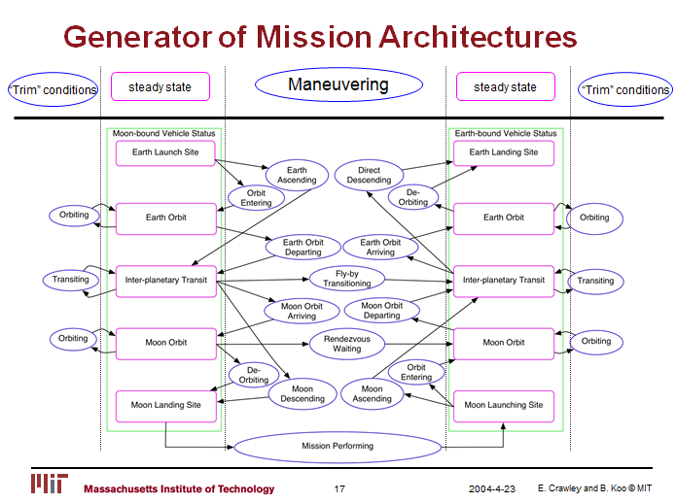
Complex Diagram Can be Simplified by Category Theory
Represents ALL possible trajectories to the moon
NKS 2004, MIT A New Kind of Language for Complex Engineering Systems
Case Study: NASA’s Apollo Program Benjamin Koo
Edward F. Crawley

Slide 32
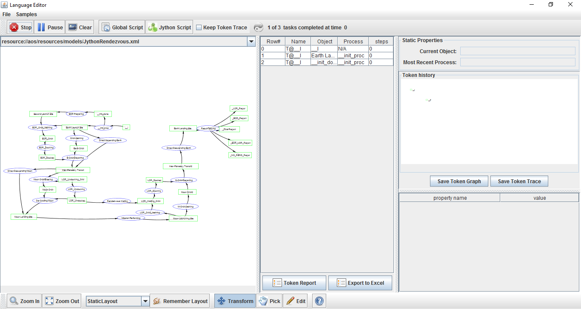
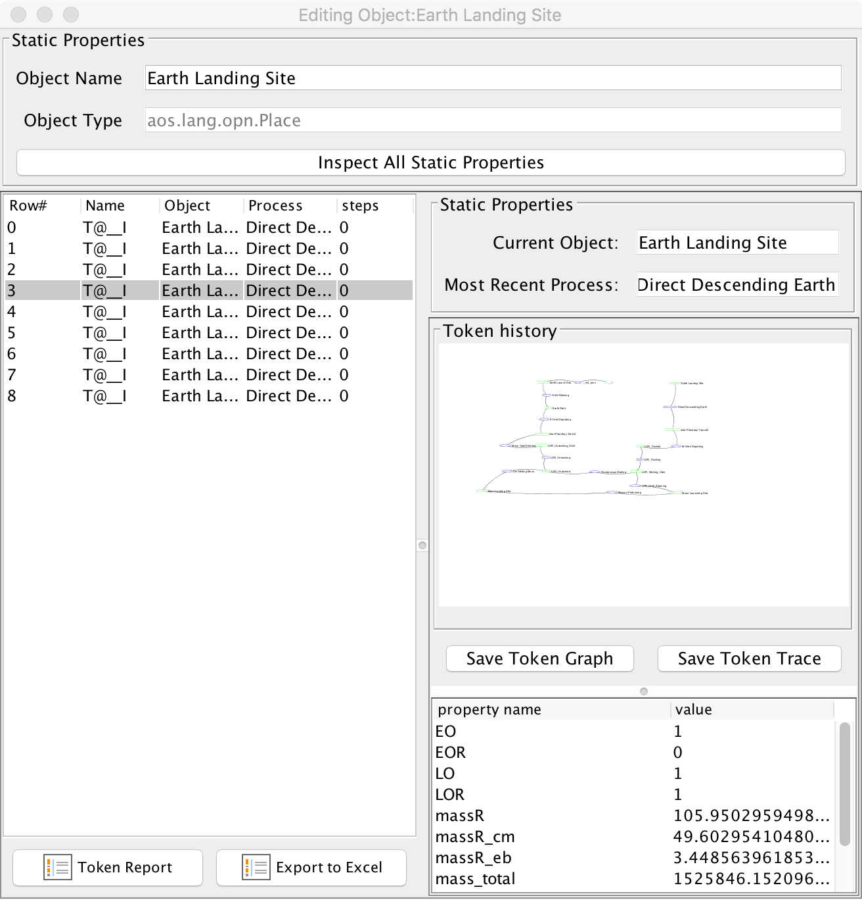
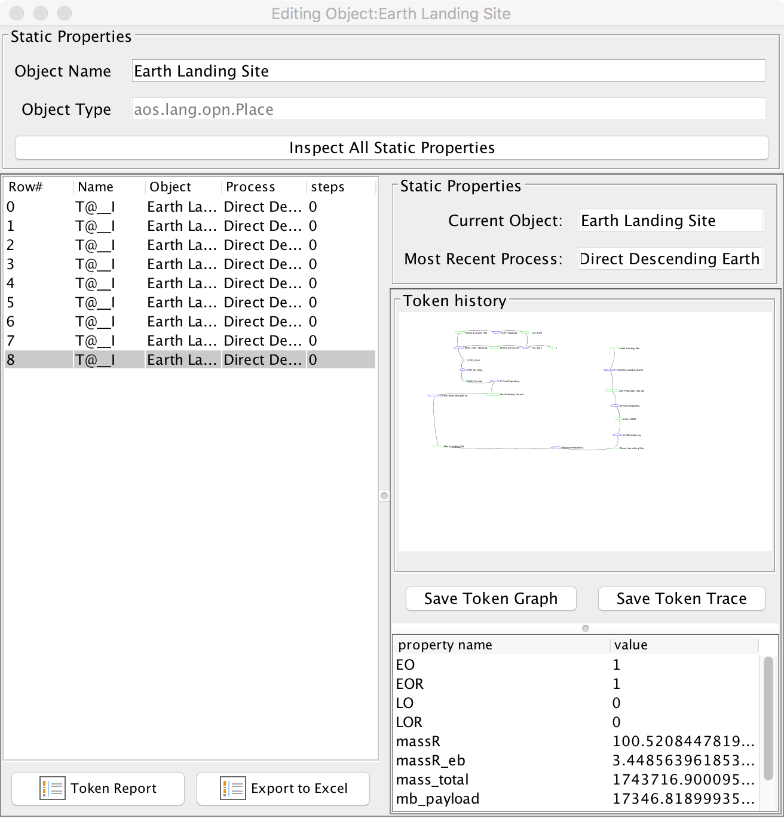
Complex Diagram Can be Simplified by Category Theory
CATEGORY THEORY
OPN Program
computes all the possible
trayectories to
the moon and
back
Author:
Benjamin Koo

Slide 33

Diagrammatic Language that reached Industrial Standard
Author:
Benjamin Koo
https://www.modelica.org/publications/newsletters/2012-1

Slide 34
How Category Theory Simplifies Product Development
For a start-up, there are two possible outcomes which define two maneuvers, one reversible:
Succeed after a process, advance
Failed after a process, repeat, roll back [opposite from advance]
Repeat
Identify customer needs and problems
Advance
Advance (R&D)
Repeat
Roll Back
Roll Back
Repeat
Target specification and proof of concept
Roll Back
Development techniques / framework
Advance

Slide 35
How Category Theory Simplifies System Development
Can be simplified as : Curry-Howard Correspondence
A
B
Domain
Codomain
Data Gathering
Data Specifications
Identity Functor
Identity Functor
Eevery connection is reversible
Codomain
Domain
Infinite possibilities!!!
Find the viable paths to succeed!
Notes:
Identity functor

Slide 36

Guide book
https://dewabharata.gitbooks.io/category-theory-for-dummies-by-dummies/content/

Slide 37



Conclusion
Category theory
Everyone is using it without knowing
Subconscious in daily life
Identify
Program Network
Predict formerly unpredictable
Solve the mysteries of life
Start-up viability
Notes:
Predict formerly unpredictable

Slide 38
Conclusion
Category Theory
Viable airspace
trajectories
Blockchain
Is the tool to represent and compute complex Networks
Cognitive and Brain Science
A.I. decision Matrix
Start-Up viability
Predict formerly unpredictable
Solve the Mysteries of Life
Notes:
Predict formerly unpredictable

Slide 39



Conclusion
Big Data
Blockchain
Shared Economy
For solving problem in frontier with massive information, big data, brand new P2P economy, blockchain revolution, cryptocurrency
We need a tool, Category Theory
Notes:
For solving problem in frontier with massive data, information overload, big data, brand new peer to peer economy, blockchain revolution, cryptocurrency
you need complexity tool: Category Theory

Slide 40
Conclusion
The Curry–Howard correspondence is the observation that two families of seemly unrelated formalism:
“The proof systems on one hand, and the models of computation on the other—are in fact the same kind of mathematical objects.”
Source: Curry–Howard correspondence
https://en.wikipedia.org/wiki/Curry%E2%80%93Howard_correspondence
Notes:
For solving problem in frontier with massive data, information overload, big data, brand new peer to peer economy, blockchain revolution, cryptocurrency
you need complexity tool: Category Theory

Slide 41
References
John Baez (2013). John Baez’s Stuff. http://math.ucr.edu/home/baez/
Marquis, Jean-Pierre, "Category Theory", The Stanford Encyclopedia of Philosophy (Winter 2015 Edition), Edward N. Zalta (ed.), URL <https://plato.stanford.edu/archives/win2015/entries/category-theory/>. First published on Dec 6, 1996. It was last modified on Oct 4, 2015.
Crawley, E.F., & Koo, B. (2004). A New Kind of Language for Complex Engineering Systems, Case Study: NASA’s Apollo Program. Dissertation for Engineering Systems Division Department of Aeronautical and Astronautical Engineering, Massachusetts Institute of Technology
Eppinger, S., & Ulrich, K. (2015). Product design and development. McGraw-Hill Higher Education.
Schalk, A., & Simmons, H. (2005). An introduction to Category Theory in four easy movements. Notes for a course offered as part of the MSc. in Mathematical Logic, Manchester University.
The correspondence was first made explicit in Howard 1980. See, for example section 4.6, p.53 Gert Smolka and Jan Schwinghammer (2007-8), Lecture Notes in Semantics
Curry–Howard correspondence, https://en.wikipedia.org/wiki/Curry%E2%80%93Howard_correspondence
Notes:
Predict formerly unpredictable

Slide 42
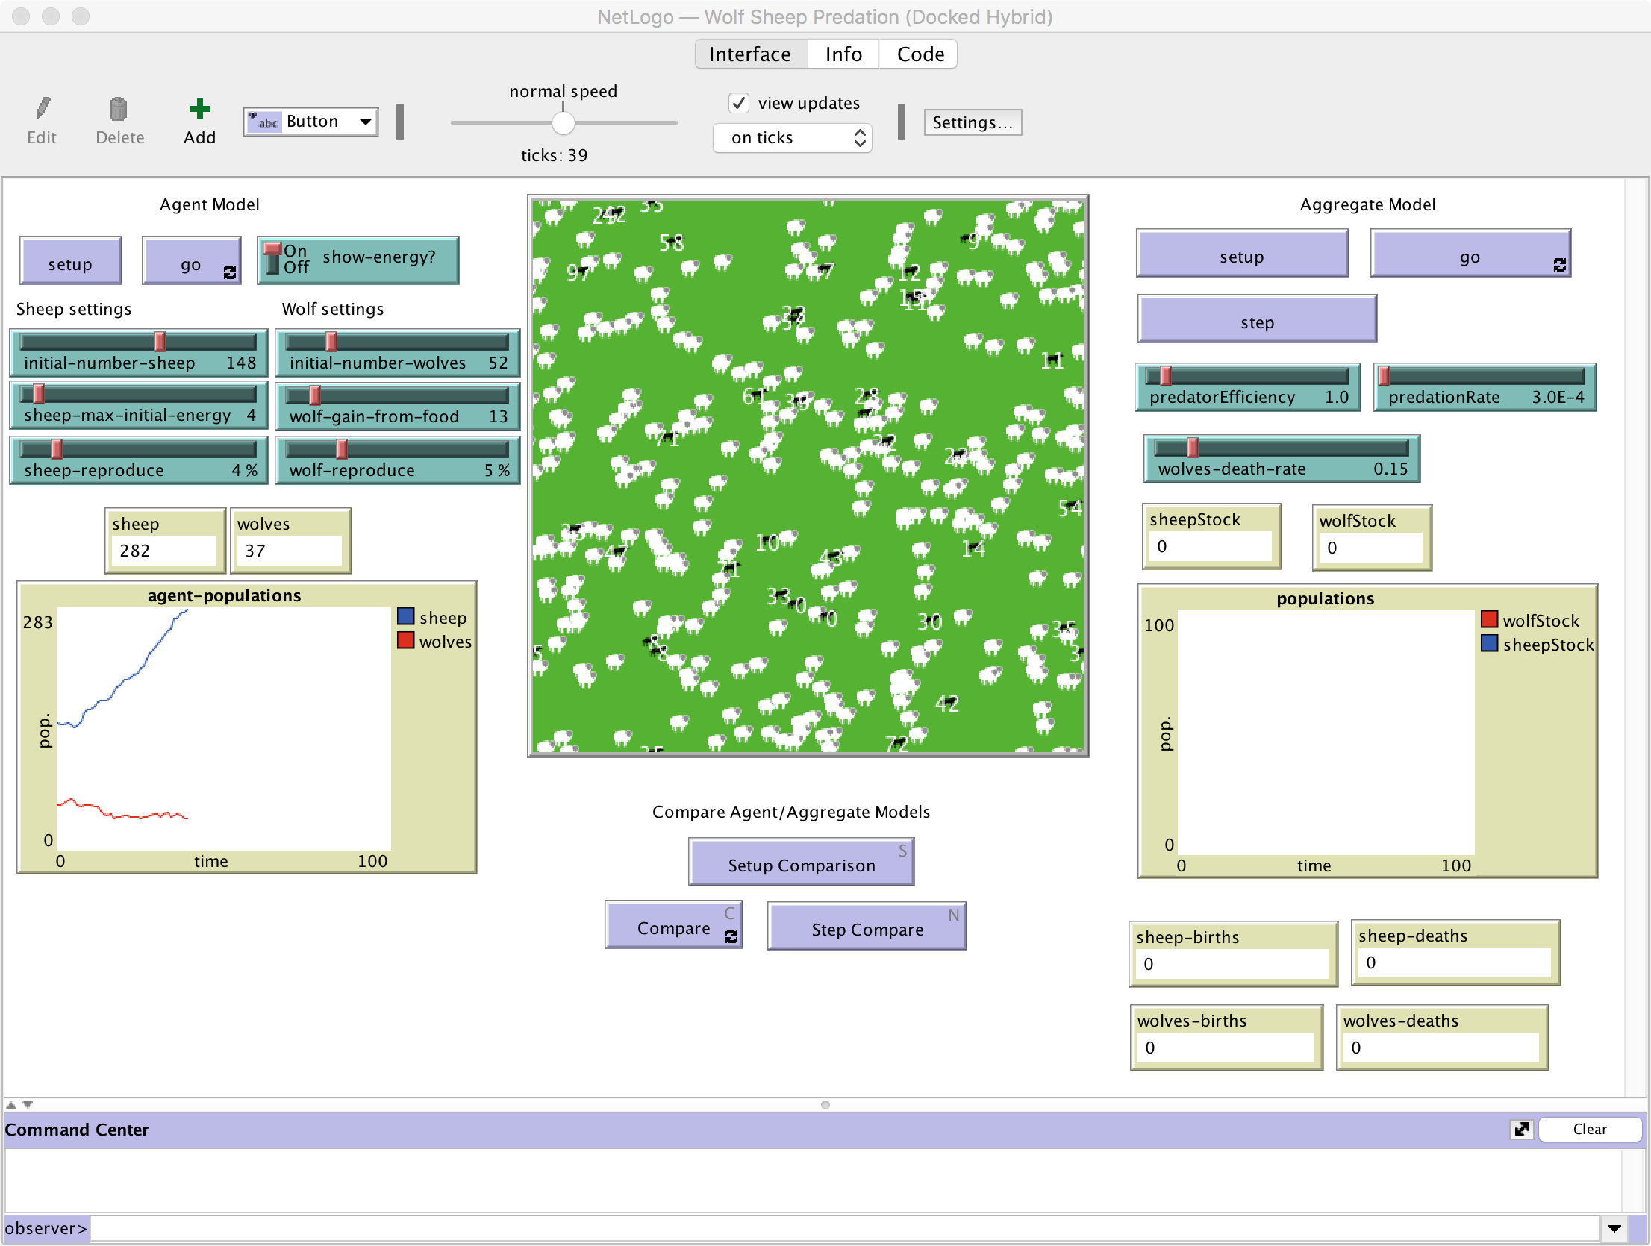
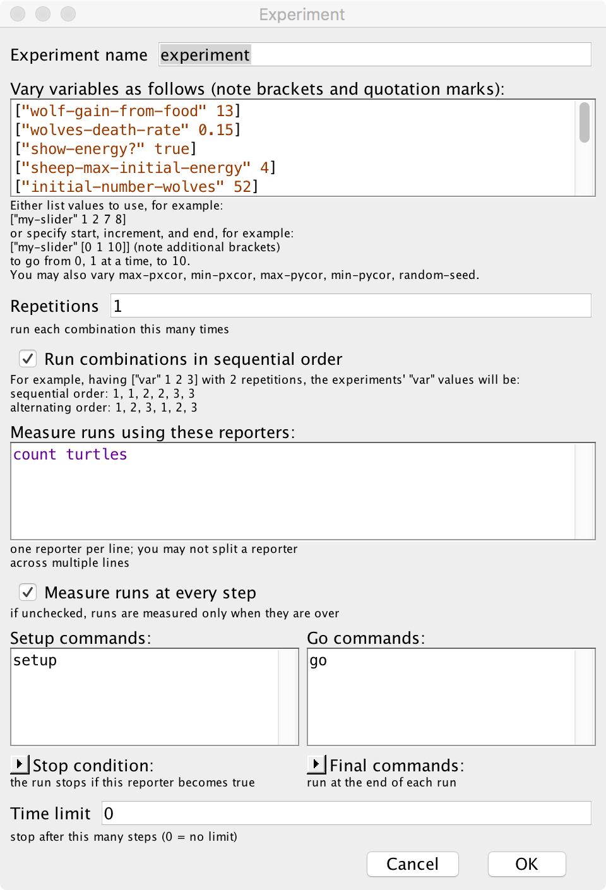

The Simulation Tool for Dynamic Social Phenomenon（NetLogo)

Slide 43
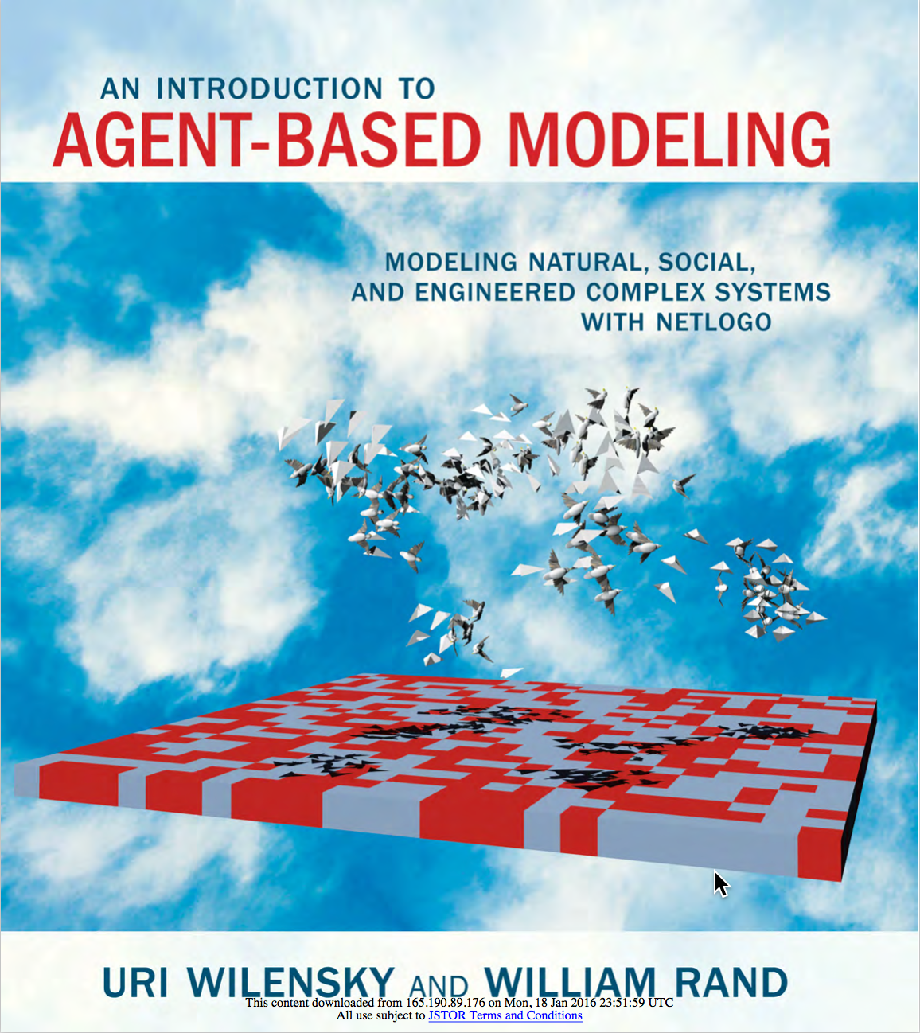
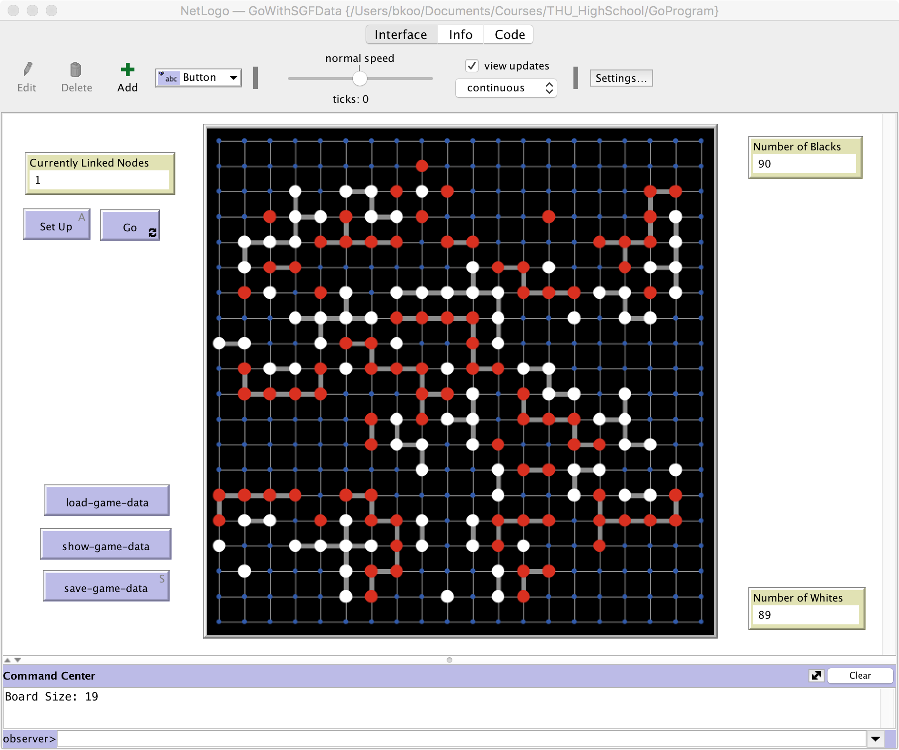
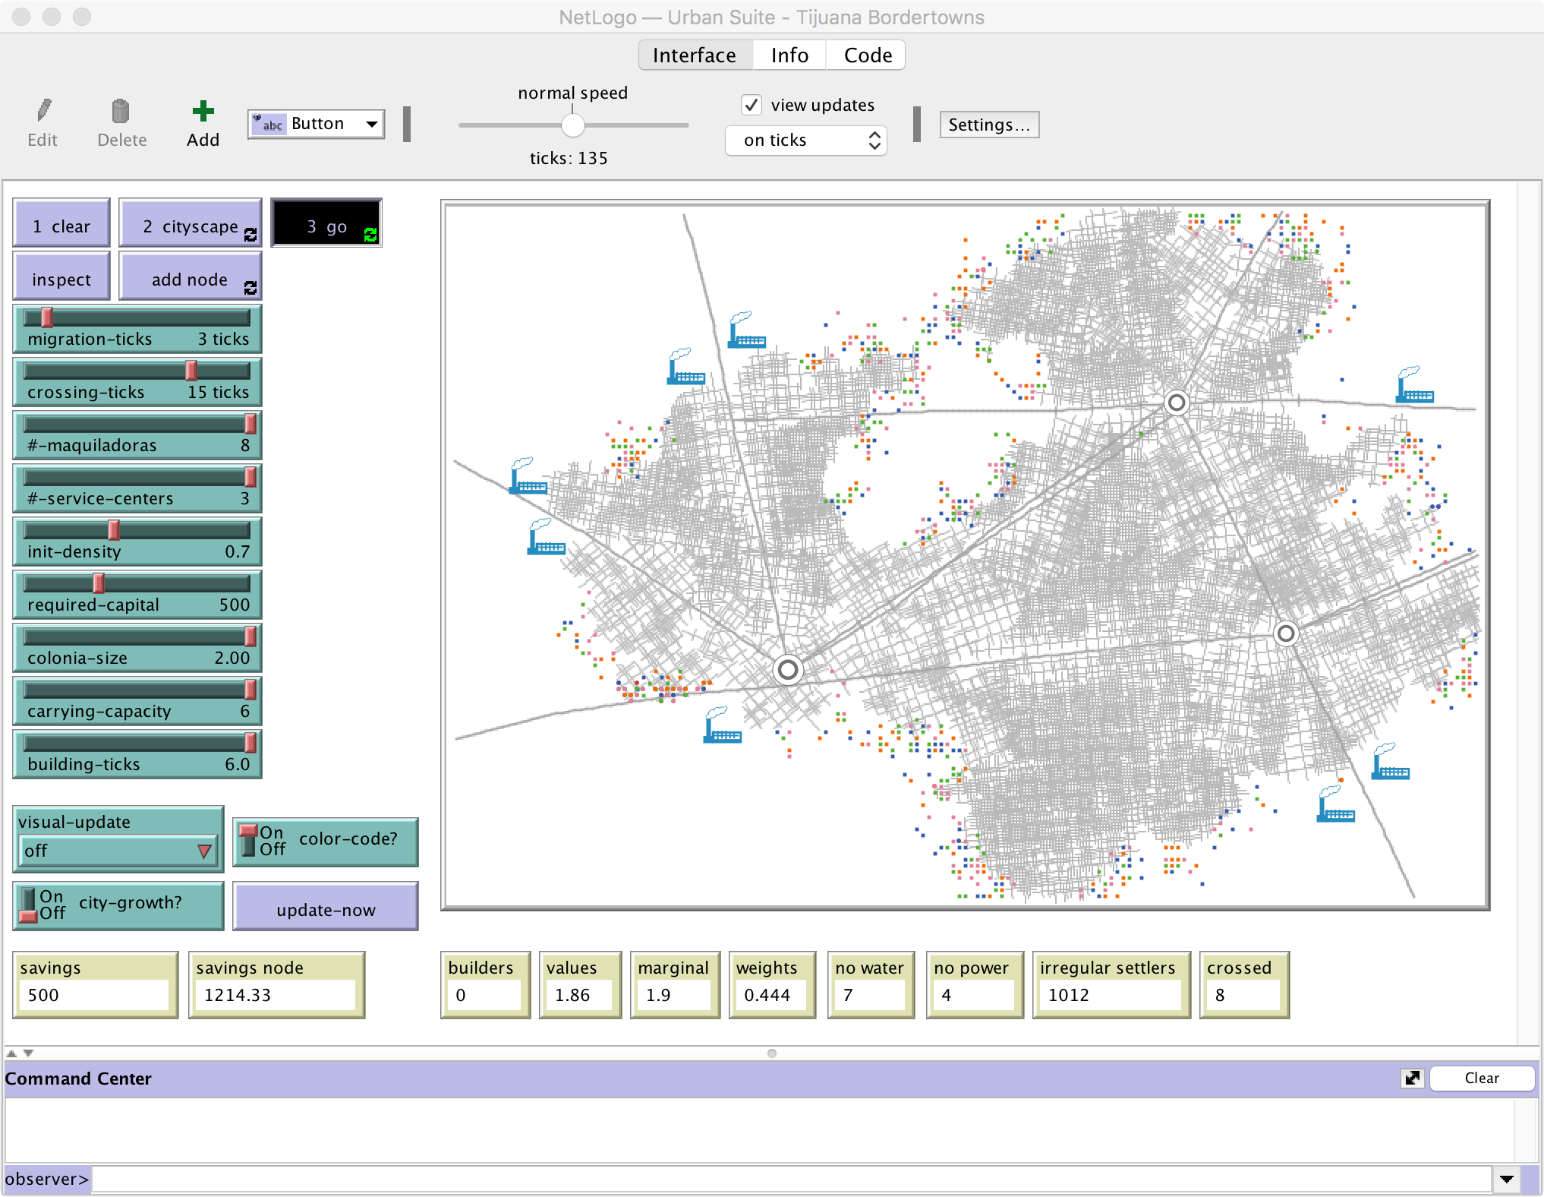
Tools and Information Processing Framework
Agent-based Modeling

Slide 44
Innovation and Entrepreneurship Based on Computational Thinking
02.

Slide 45






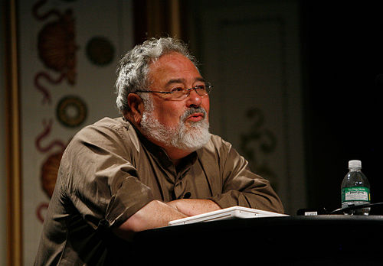

Knowledge System of Computational Thinking
Software
Hardware
Gene Evolution
Neutral Network
Symbolic Logic
Causal Probability
Cognitive Semantics
T. Kuhn
Content
IoT and Quantum Computing
TPU
GPU
CPU
Big Data
Computed Data
Artificial Data
Thinking
Standard
D. Hassabis
Distributed
Centralized
General Protocol
S. Wolfram
Extreme Learning Process
J. Pearl
Forms of Knowledge
Computable collective learning system
G. Lakoff
Memory space, theme
Computational ability, energy, equipment
Coding strategy, structure, algorithm

Slide 46
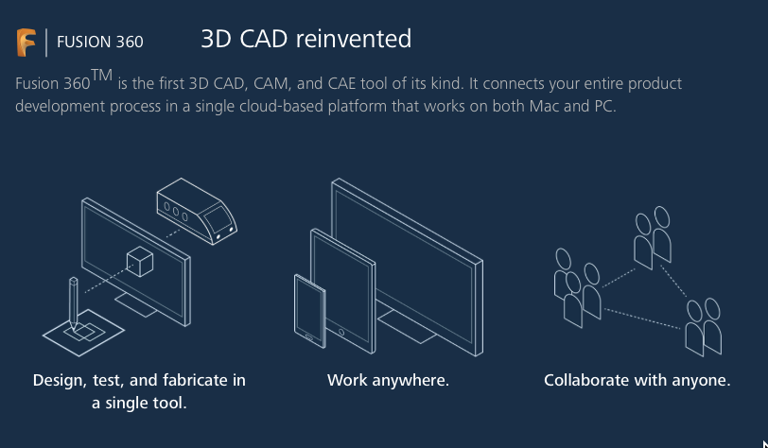


A Full Stack Tool which can Support Knowledge, Product Design, Fabricate, and Production Synergy？

Slide 47
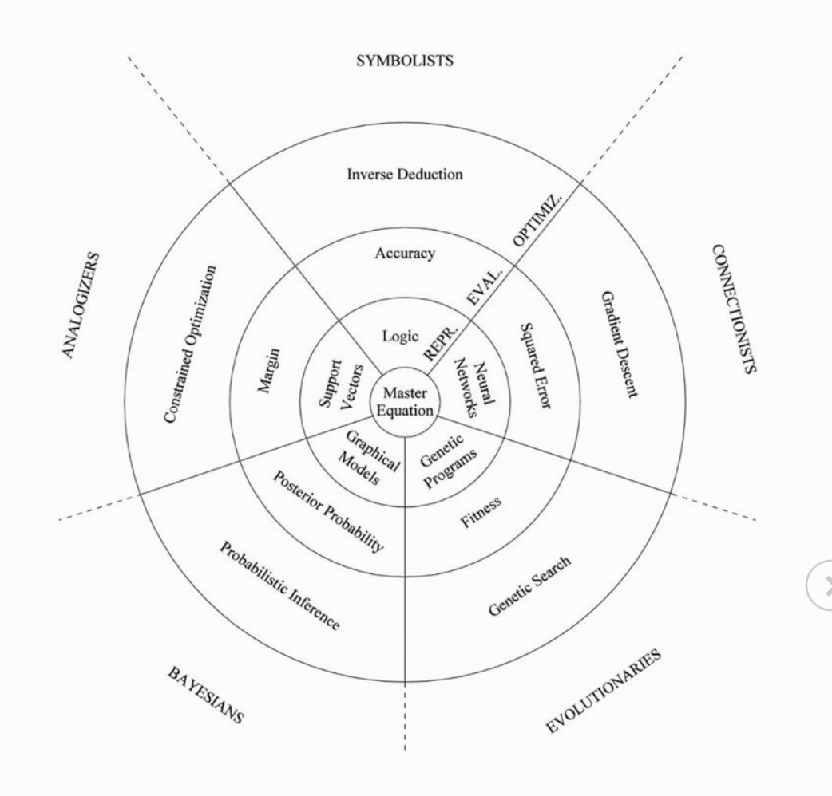
Five Factions of Algorithm

Slide 48


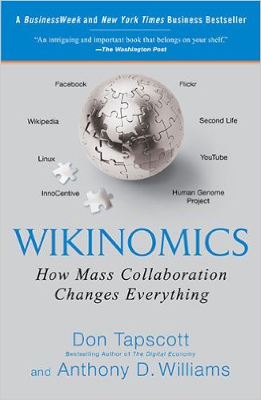
Computation of Reliability
Time
Space
Reliability

Slide 49
Conclusion
Social Order：sorting by cooperative capability
Protocol framework is decided by Cyber-physical System
Economic order is decided by by intellectual property rights, transaction frequency/ total quantity, and currency distribution right.
Intellectual property, transaction effectiveness, and currency issue are three levels of strategic awareness
The leading force of industry development, from the insight on multi-level system architecture evolution orientation
The future society development must be built on a computational thinking based cognition system
Extreme Learning Process (XLP): is a kind of knowledge management operational system that based on computational thinking of managing multilevel group knowledge （ABC curriculum system）

Slide 50



The eXtreme Learning Process based on Computational Thinking
Reliability
Time
Space

